Slide 1
Union Labor Analysis
Divine Uhunmwangho

Slide 2
Introduction
Unions have always had an enormous role to play within economy throughout the world. They advocate for worker rights Increase worker pay and allow workers to live despite challenges that they may face. Unlike Union Jobs employment without unions typpicallly lack these Protections.

Slide 3
Project Objective
Does being employed in an occupation associated with unions lead to higher Wages?

Slide 4
Methodology
Step 1: Data Processing
Step 2: Data Cleaning
Here we just use the OWEs query system to look for the data we need then structure it in an excel sheet and import to pandas
Here i built a function to clean Dataframes and then i applied this to the different occupation data
Step 4: Data Visualization
Step 3: Data Aggregation
After the Data has been grouped and processed I then made visualizations that compared occupations by unionhood
I grouped the data together and had them split by occupations i classified as low unionhood or high huniohood

Slide 5
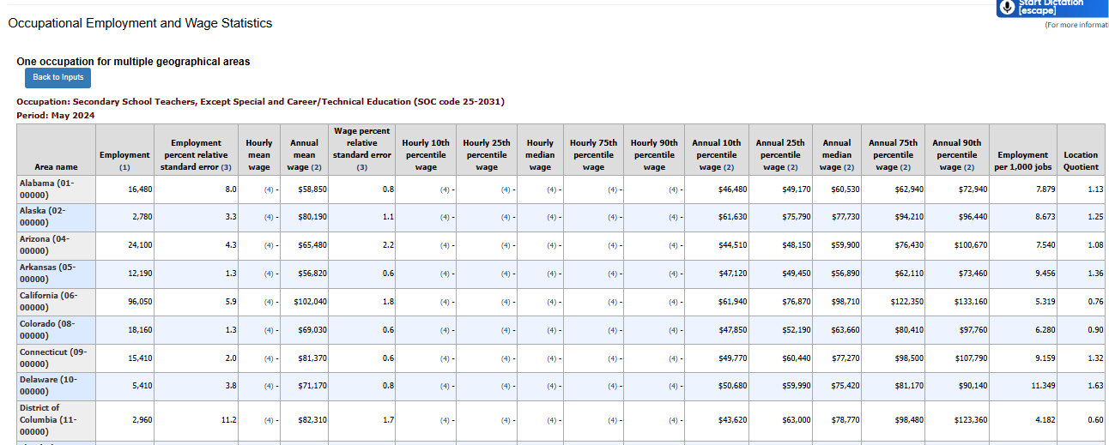
Original Data (Sample)

Slide 6
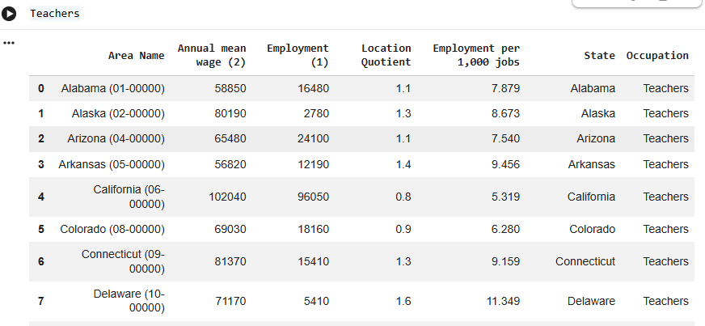
Cleaned Data (Sample)

Slide 7

Key Findings

Slide 8
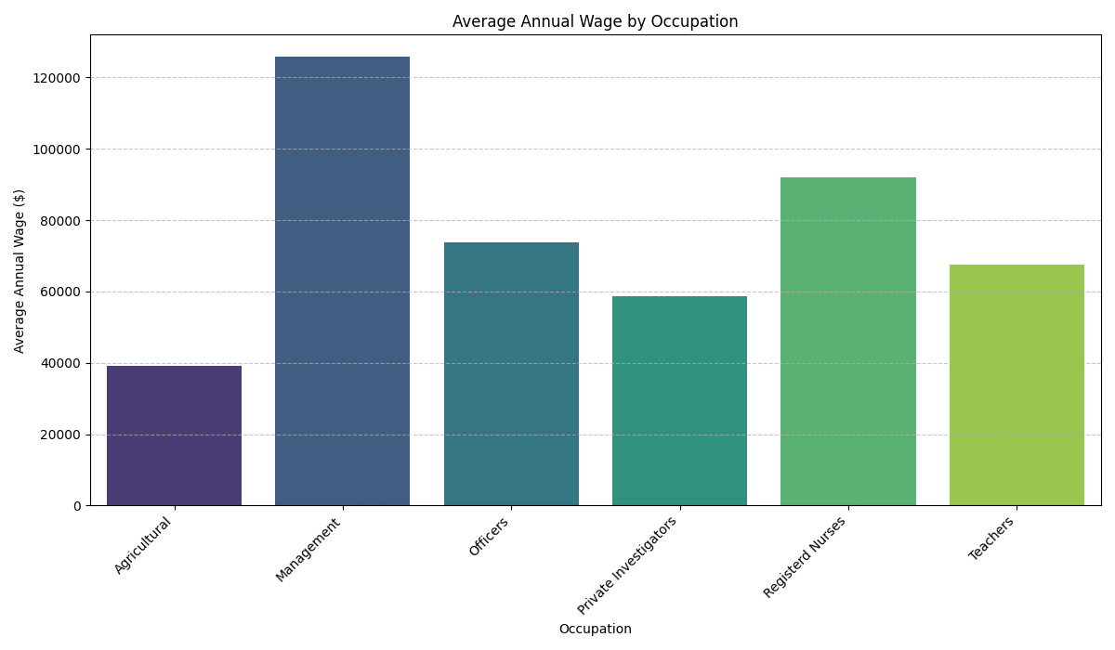
Average Wage by Occupation
This Chart shows The occupations i used and their average wages and it also highlights that manager wages are far higher than the rest

Slide 9
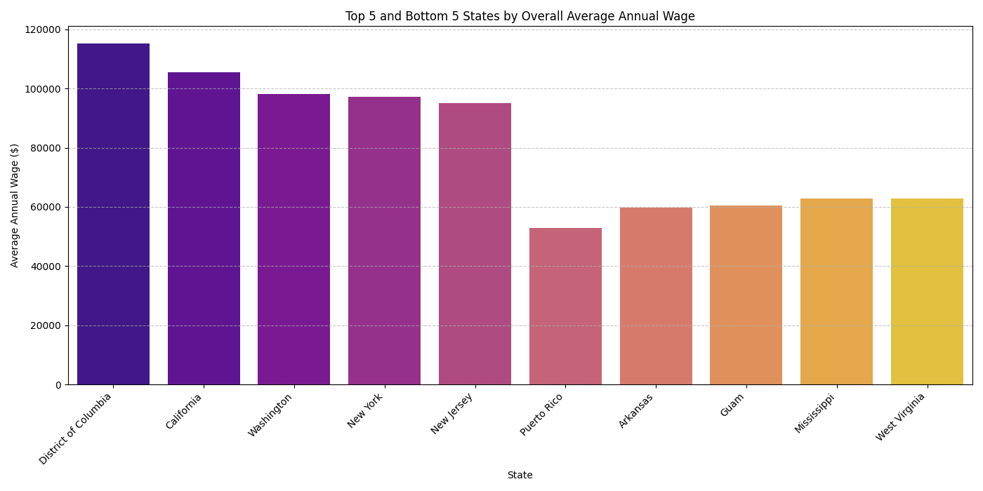
Top 5 & Worst 5 States by Wage
This chart is the top 5 and bottom 5 states for wages within all the data and is important for the next slide

Slide 10
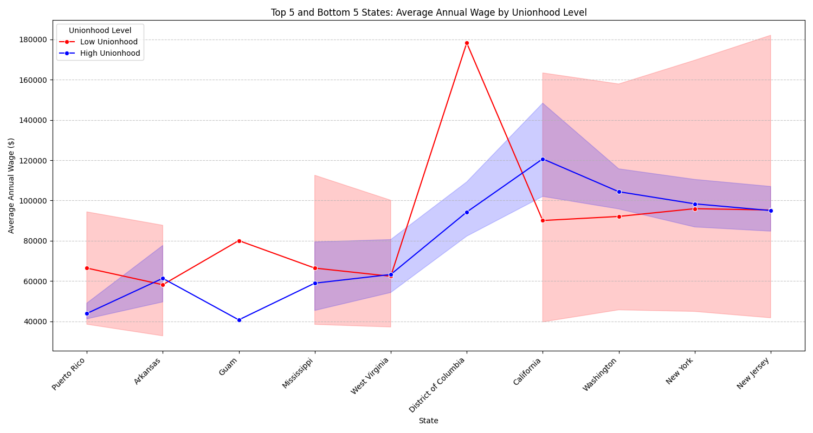
wages in top 5 & worst 5 States by union hood
This chart shows that while wage performance is heavily influenced state regardless of unionhood
Occupations with low unionhood tend to perform better

Slide 11
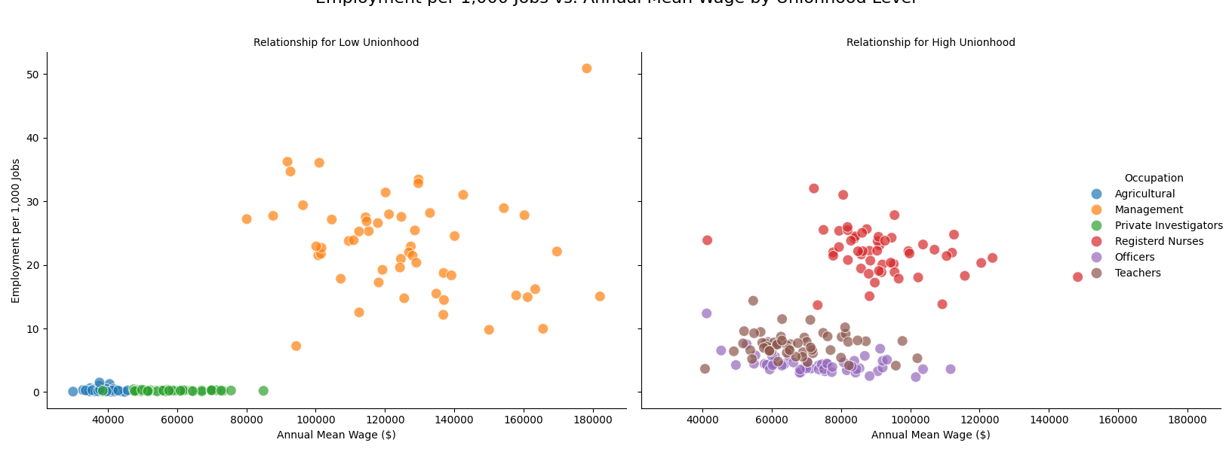
Employment Rarity vs Wage
This chart shows that there are a large amount of management workers in comparison to agriculture and private investigators within low wages. The conclusion here is that while some low union jobs have less workers they still seem to make more generally than union workers with the exception of agriculture

Slide 12
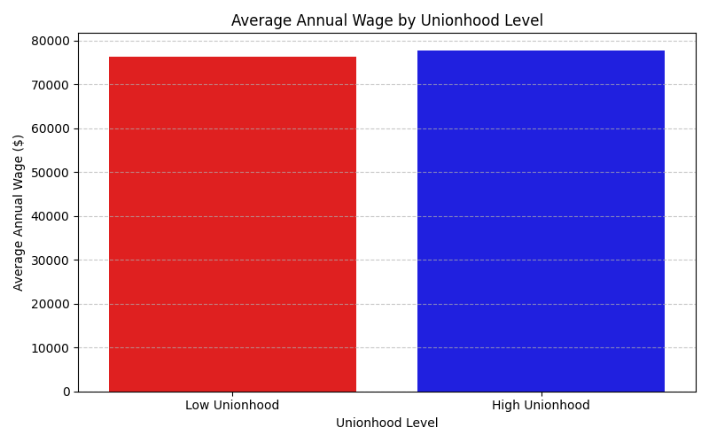
Wage By Unionhood Level
This Chart does answer our questions as it shows that occupations with high unionization have slightly higher income.

Slide 13
Biases and Limitations
Within the 6 occupations I chose a clear existing basis is that agricultural wages are far too low and management wages are far too high. While these occupations both heavily lack unions Using them might have skewed the data.
Now while i was searching for replacements for management I saw that jobs associated with unions were typically high paying regardless
So while agriculture does skew my data because it is the sole occupation incapable of forming unions due to federal laws I feel that it has to be included within analysis of low unionization occupations

Slide 14
DATA Sources and References
U.S. Bureau of Labor Statistics. (n.d.). Occupational employment and wage statistics (OEWS) data. U.S. Department of Labor. https://data.bls.gov/oes/#/home
Stack Overflow. (n.d.). Stack Overflow. Stack Exchange Inc. https://stackoverflow.com
McKinney, W. (2017). Python for data analysis: Data wrangling with pandas, NumPy, and IPython (2nd ed.). O’Reilly Media.

Slide 15
Questions?

Slide 16
Thanks For
Wathing!!!
Insta: @divin_ol

